Slide 1
Male Fertility Test
Project 3 Team: Gautam Doshi, Reena Agrawal, Rika Fukamachi
November 9, 2019

Slide 2
Issue Description
Historically, when it comes to infertility, there are more studies and treatments performed on women than men
Interest in men’s role in fertility issues started in the late 19th century
The most conclusive way was to collect and examine their sperm sample
Since then, many studies have been conducted to correlate sperm quality with health status, life habits and environmental factors.
Although perceptions have changed over the years, the issue remains that some men don’t feel comfortable providing a semen sample

Slide 3
Solution
Thanks to those studies, we now have a less intrusive way of predicting male fertility
In the privacy and comfort of his own home, he can go to this website, answer a few questions, and get an answer as to their probability of infertility
As a bonus this site also has recommendations and links to resources

Slide 4
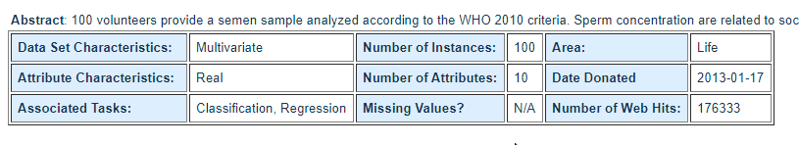
Data Source
UCI Machine Learning Repository
Fertility Data Set

Slide 5
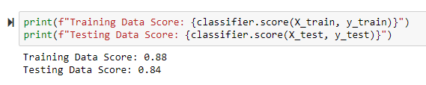
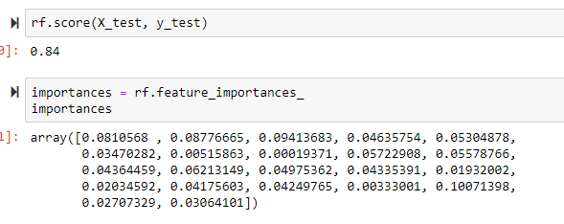
Using Machine Learning
Logistic Regression
Using sklearn.linear_model.LogisticRegression
Random Forest Classifier
Using sklearn.ensemble.RandomForestClassifier

Slide 6
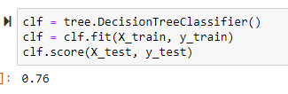
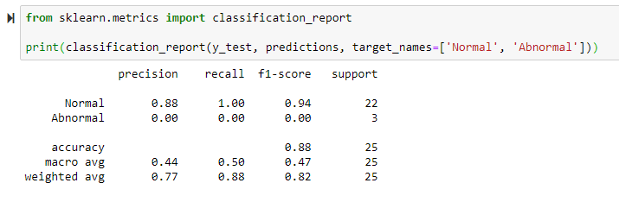
Using Machine Learning
Decision Tree
Using sklearn.tree
Serial Vector Machine
Using sklearn.svm.SVC

Slide 7
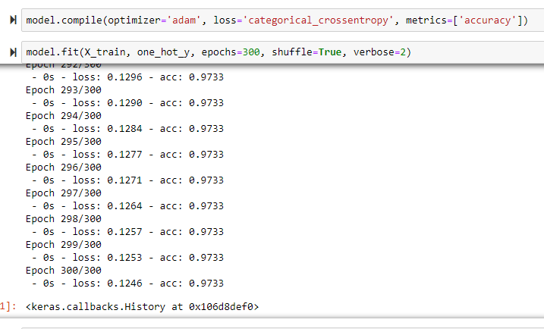
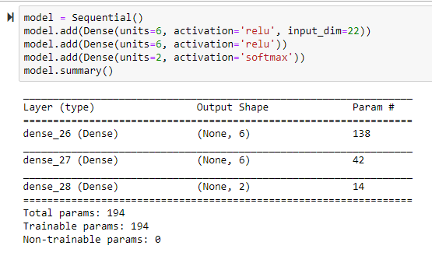
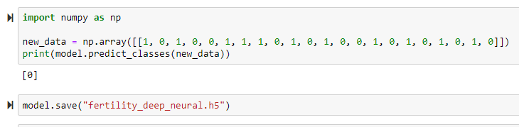
Using Machine Learning
Deep Neural Model Train and Test
Using tensorflow, keras, sklearn.preprocessing.LabelEncoder, one hot encoding

Slide 8
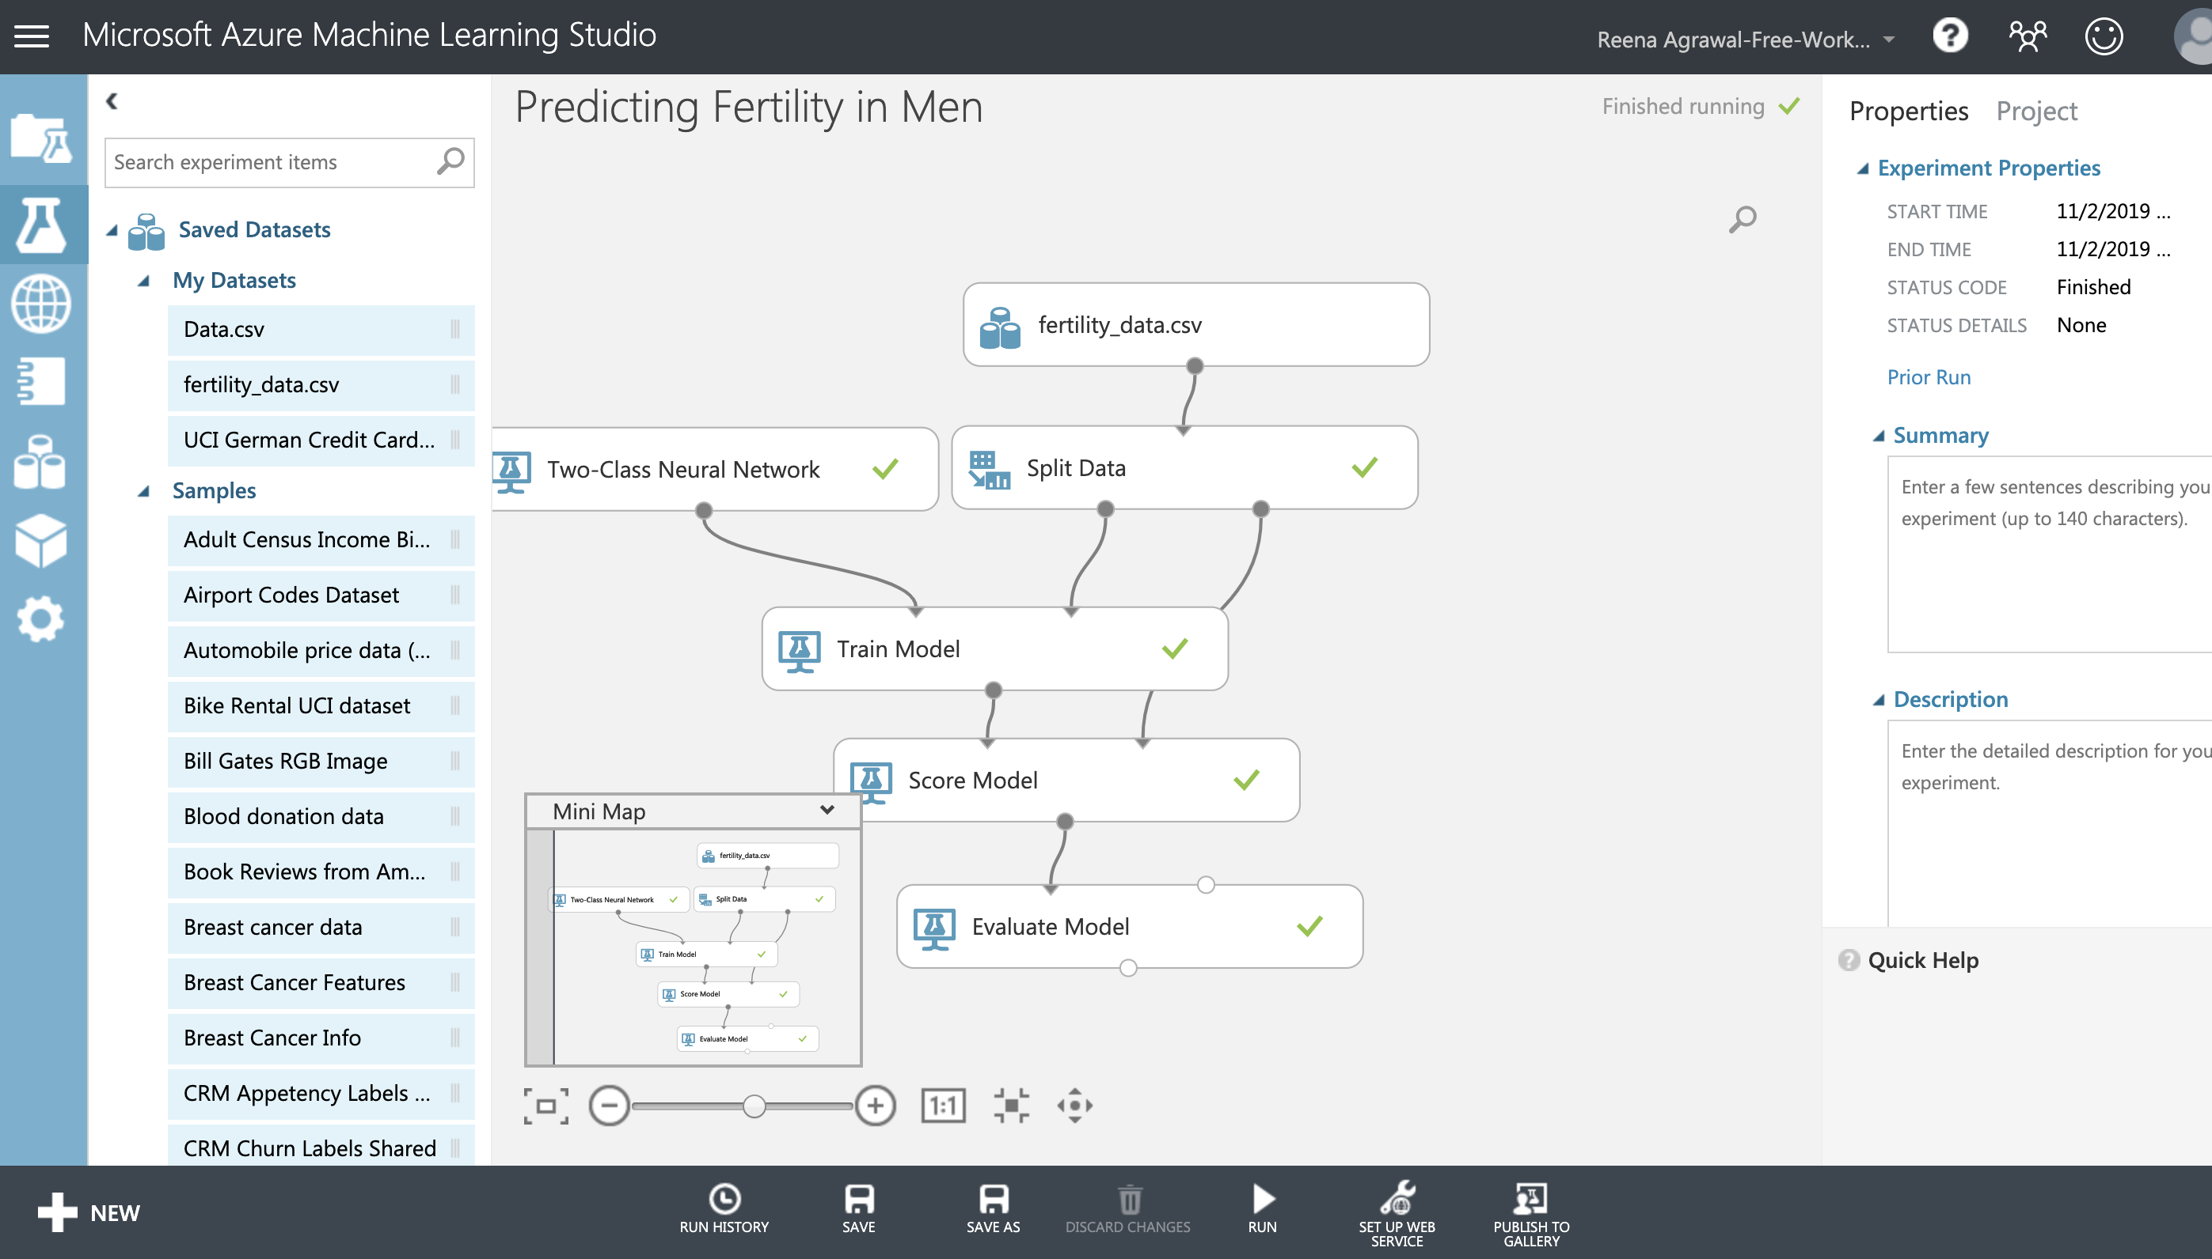
Azure Machine Learning

Slide 9
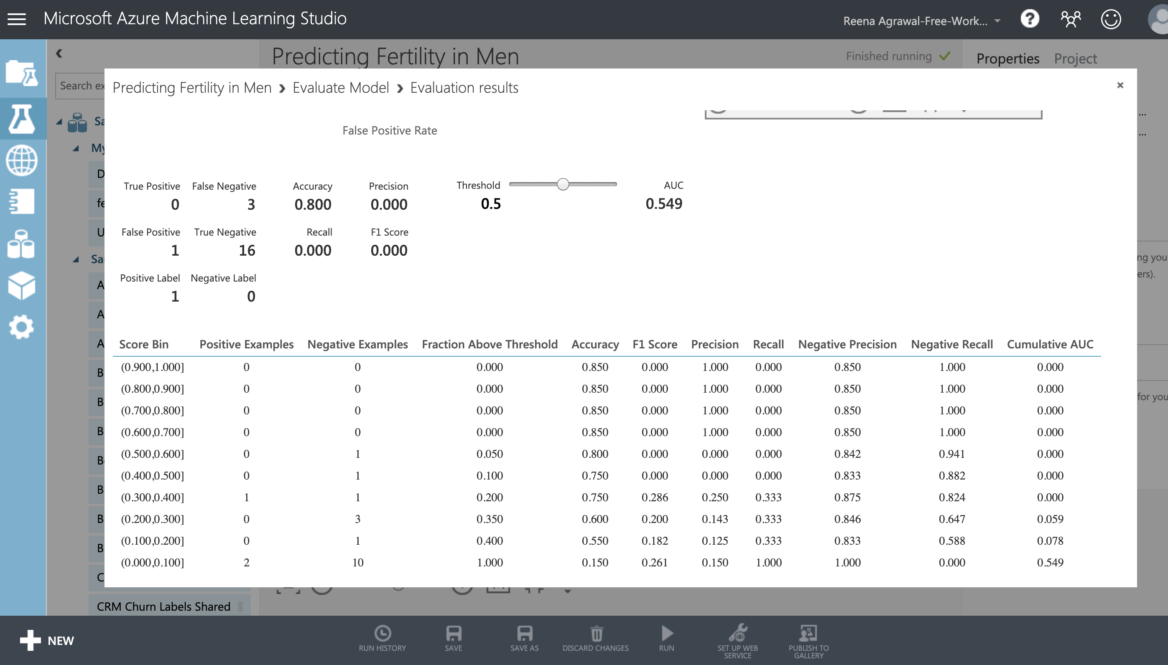
Azure Machine Learning

Slide 10
AWS – Amazon Web Services
S3 to store webpages
API Gateway – activated by the submit button and triggers the Lambda function
Two Lambda Functions
First to pull in the responses from and post the results to the HTML page
Second to send the responses to and receive the predictive analytic results from MS Azure via an API call
IAM to control security
To control user and function security

Slide 11
Tools Used
Python Pandas, Scikit-Learn, TensorFlow, Keras
HTML/CSS/Bootstrap
Javascript
Node JS
Amazon AWS
Microsoft Azure

Slide 12
References
https://medicalxpress.com/news/2014-09-history-medical-male-infertility.html
https://medium.com/@katylindemann/fertilityfellas-a-brief-history-of-male-infertility-e2b04bb6b372
https://www.sciencedirect.com/science/article/pii/S0957417412007269
https://archive.ics.uci.edu/ml/datasets/Fertility

Slide 13
Demo

